Slide 1
Vertebrate Circulation
From Fish to Mammals

Slide 2
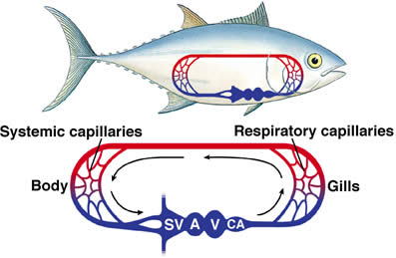
Fish Circulation
Fish
Diagram
One way
Sinus venosus to atrium to ventricle to conus arteriosus to gills to tissues back to the SV.
http://www.hhmi.org/biointeractive/circulatorium/frames.html

Slide 3
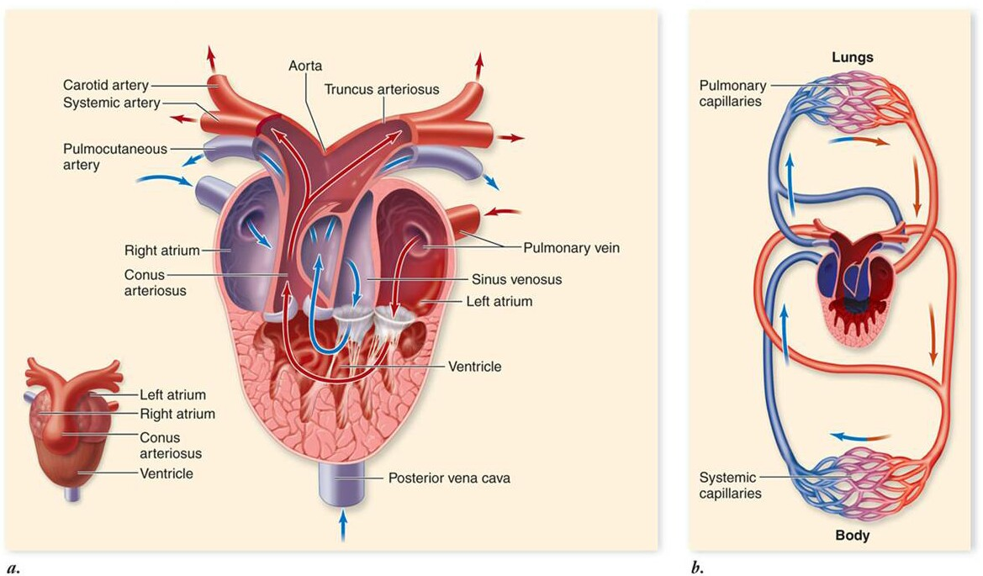
Amphibian Circulation
Loop
Septum separates
atria into right and left
halves
Pulmonary veins carry
oxygenated blood from
the lungs to the heart
through the left atrium
Ventricle pumps blood
from the heart
Deoxygenated blood enters
The right atrium to the sinus
venosus to the ventricle through the
Pulmocutaneous artery to the lungs.
http://www.hhmi.org/biointeractive/circulatorium/frames.html
Diagram

Slide 4
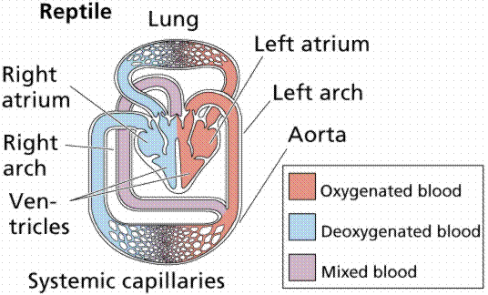
Reptile Circulation
Septum extends into the ventricle
Blood going to the body is more oxygenated than amphibians
Ectothermic – cannot maintain body temp. through metabolism. Must get heat from external source

Slide 5
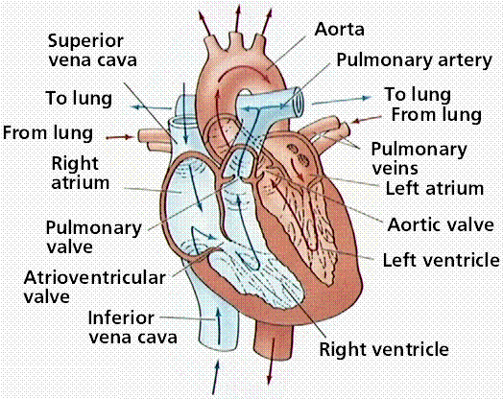
Bird and Mammal Circulation
4 chambered heart
No mixing of blood
Birds have multiple airs sacs for the most oxygen available to the lungs.
Mammals have less oxygen per unit blood

